Slide 1
CS 211: Computer Architecture Digital Logic
Abhishek Bhattacharjee
Reading:
Chapter 4: Section 4.2

Slide 2
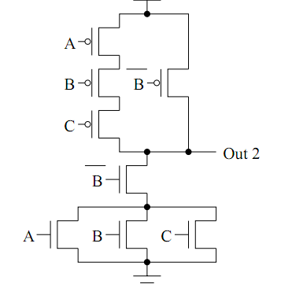
What is this?
A | B | C | Out
0 | 0 | 0
0 | 0 | 1
0 | 1 | 0
0 | 1 | 1
1 | 0 | 0
1 | 0 | 1
1 | 1 | 0
1 | 1 | 1
1
0
1
1
0
0
1
1

Slide 3
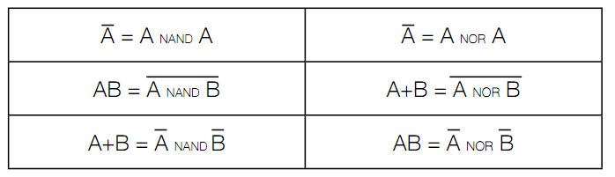
NAND, NOR universality
NAND, NOR universal because they can realize AND, OR, NOT

Slide 4
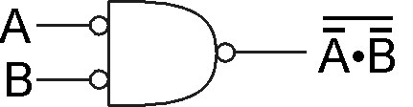
DeMorgan's Law
Converting AND to OR (with some help from NOT)
Consider the following gate:
To convert AND to OR
(or vice versa),
invert inputs and output.
A | B
0 | 0 | 1 | 1 | 1 | 0
0 | 1 | 1 | 0 | 0 | 1
1 | 0 | 0 | 1 | 0 | 1
1 | 1 | 0 | 0 | 0 | 1
Generally, DeMorgan’s Laws:
PQ = P + Q
P + Q = P Q
Same as A+B!
Notes:
If there's time, perhaps discuss how all gates can be implemented with NAND (or NOR).
Therefore, you can implement any truth table using only NAND (or NOR) gates.

Slide 5
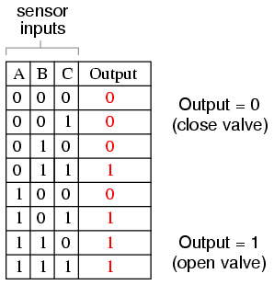
Converting Truth Table to Boolean Expression
Given a circuit, isolate the rows in which the output of the circuit should be true

Slide 6
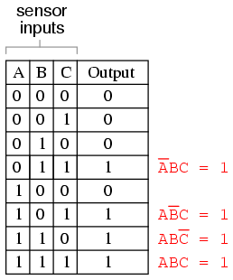
Converting Truth Table to Boolean Expression
Given a circuit, isolate that rows in which the output of the circuit should be true
A product term that contains exactly one instance of every variable is called a minterm

Slide 7
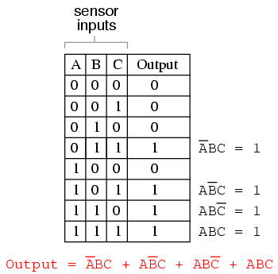
Converting Truth Table to Boolean Expression
Given the expressions for each row, build a larger Boolean expression for the entire table.
This is a sum-of-products (SOP) form.

Slide 8
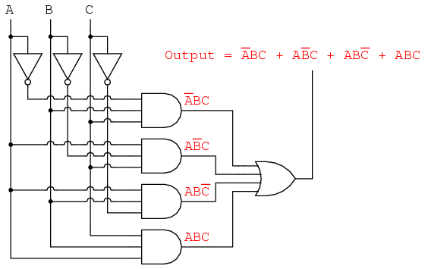
Converting Truth Table to Boolean Expression
Finally build the circuit.
Problem: SOP forms are often not minimal.
Solution: Make it minimal. We’ll go over two ways.

Slide 9
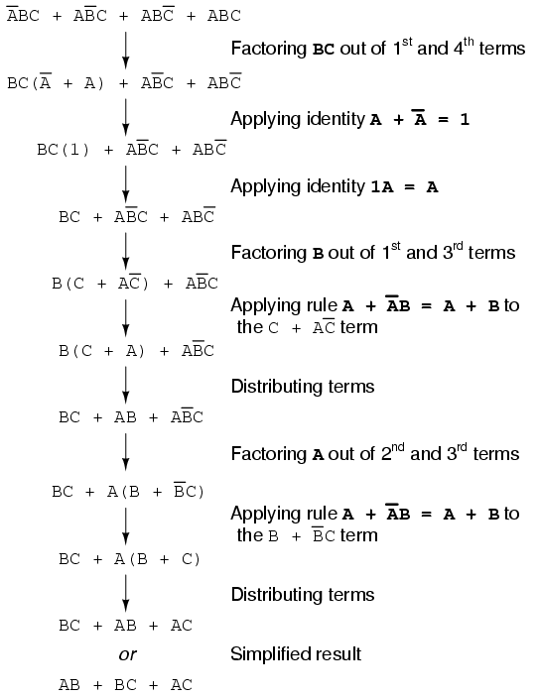
First Approach: Algebraic
Simply use the rules of Boolean logic

Slide 10
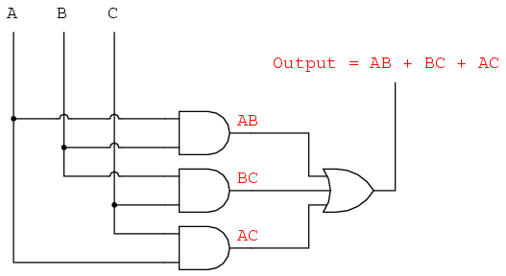
The Result

Slide 11
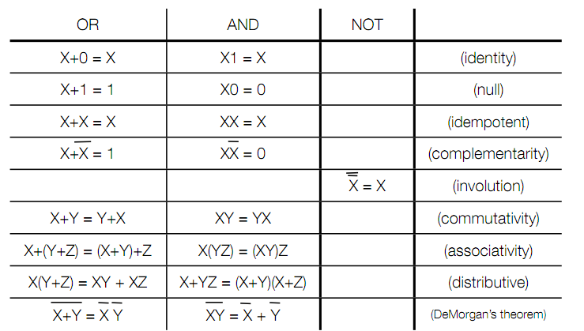
Boolean Identities

Slide 12
A Slight Detour: Terminology
Binary variable: a symbolic representation that might be 0 or 1 (eg. X, Y, A, B)
Complement: the opposite value of variable X
Literal: a boolean variable or its complement (eg, X, X)
Expression: a set of literals combined with logical operations (eg. AB + C)

Slide 13
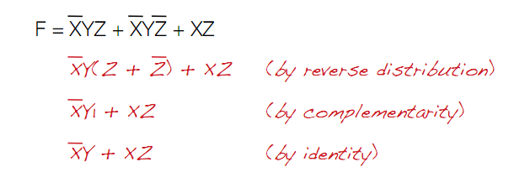
Boolean Algebra Example

Slide 14
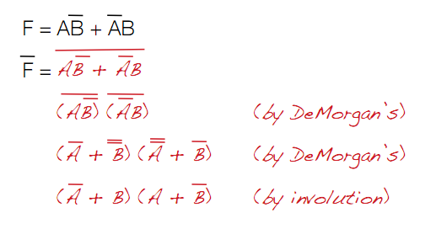
Boolean Algebra Example 2
Find the complement of F

Slide 15
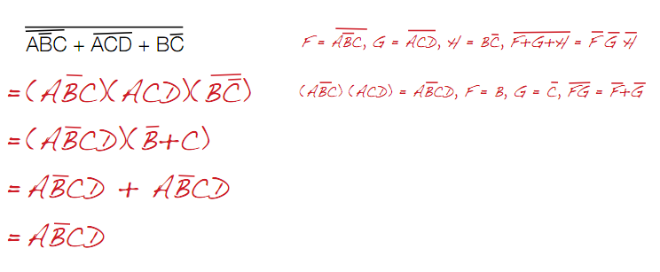
Using DeMorgan’s Laws to Complement
To big bar over AND and OR of 2 or more functions
Replace AND with OR, OR with AND
1 with 0, 0 with 1
F with not(F), not(F) with F

Slide 16
Duals
All boolean expressions have duals
Any theorem you prove, you can also prove for the dual
To form a dual
1. replace AND with OR, OR with AND
2. replace 1 with 0, 0 with 1

Slide 17
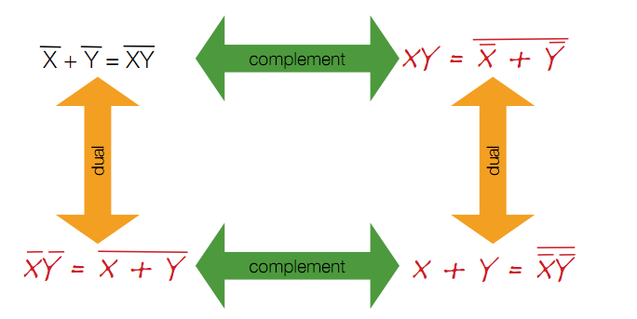
Relationship between Complement and Duals

Slide 18
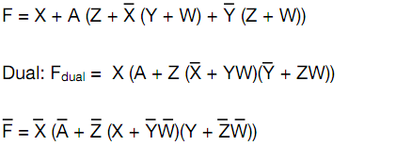
Complement Using Duals
Get dual and then complement each literal

Slide 19
Karnaugh Maps or K-Maps
K-maps are a graphical technique to view minterms and how they relate.
The “map” is a diagram made up of squares, with each square representing a single minterm.
Minterms resulting in a “1” are marked as “1”, all others are marked “0”

Slide 20
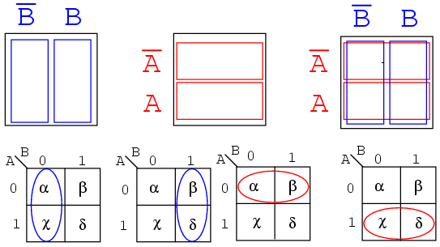
2 Variable K-Map

Slide 21
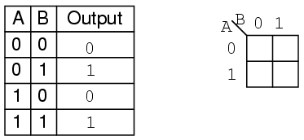
2 Variable K-Map

Slide 22
2 Variable K-Map
0
1
0
1

Slide 23
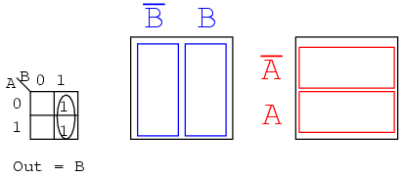
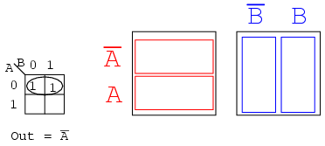
Finding Commonality

Slide 24
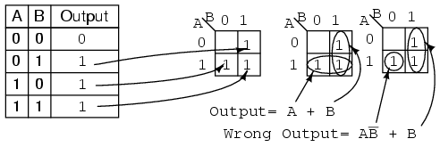
Finding the “best” solution
Grouping become simplified products.
Both are “correct”. “A+B” is preferred.

Slide 25
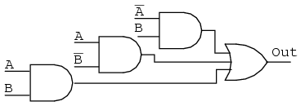
Simplify Example

Slide 26
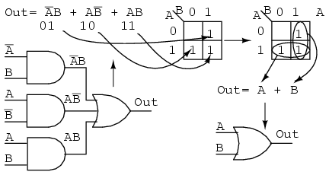
Simplify Example

Slide 27
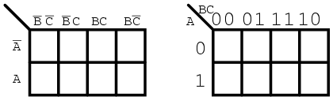
3 Variable K-Maps
C
B
Note in higher maps, several variables occupy a given axis
The sequence of 1s and 0s follow a Gray Code Sequence.

Slide 28
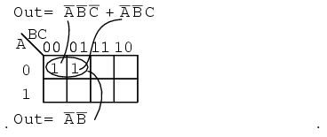
3 Variable K-Maps

Slide 29
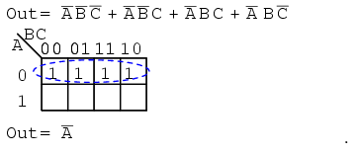
3 Variable K-Maps
C
B

Slide 30
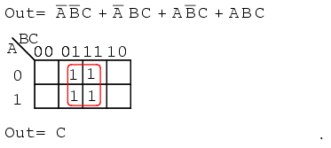
3 Variable K-Maps

Slide 31
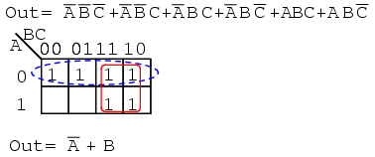
3 Variable K-Maps

Slide 32
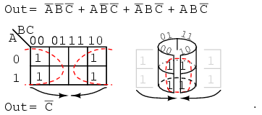
3 Variable K-Maps

Slide 33
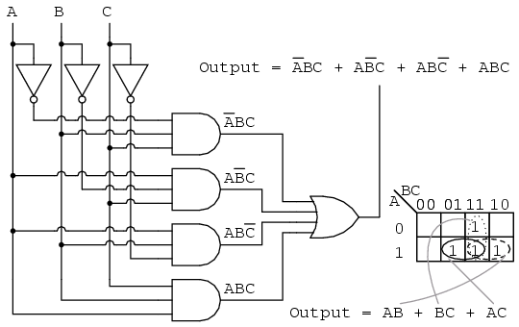
Back to our earlier example…..
The K-map and the algebraic produce the same result.

Slide 34
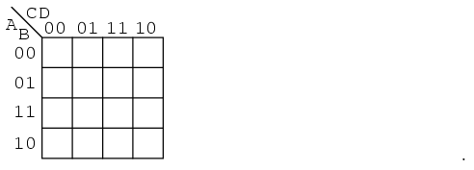
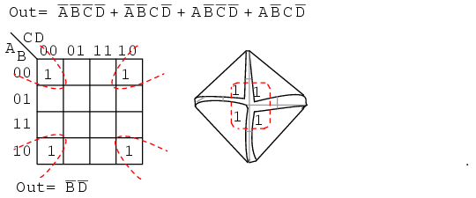
Up… up… and let’s keep going
D
B
A
C

Slide 35
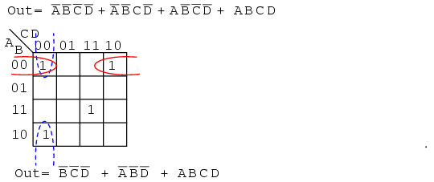
Few more examples
D
B
A
C

Slide 36
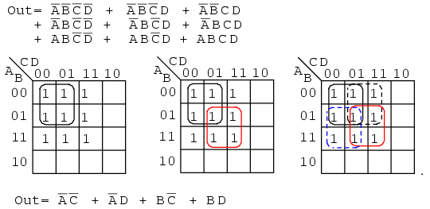
Few more examples
D
B
A
C

